Slide 1

r
Department of Computer Applications
Robust Data-Driven Analysis for Electricity Theft
Attack-Resilient Power Grid
Review - ׀׀
Presentation By:
Govardhan Reddicharla
Roll No: 23691f0049
Under The Guidance of:
Dr.Srinivasan J
Assistant Professor
Department of Computer Applications

Slide 2
CONTENTS
Abstract
Proposed methodology
Architectural design
Proposed System features and advantages
Feasibility Study
ER Diagram
UML Diagrams
DFD Diagrams
References

Slide 3
ABSTRACT
Problem statement:
Electricity theft in smart grids poses a major challenge due to data imbalance, anomalies, and evolving fraud techniques. Existing systems often fail to detect such thefts accurately, leading to operational and financial losses.
Project objectives:
To develop a robust machine learning framework that accurately detects electricity theft from smart meter data. The goal is to enhance detection accuracy, reduce false positives, and support real-time insights via a dashboard.
Brief solution approach:
The system applies preprocessing, feature selection, and SMOTE to handle imbalanced data, followed by model training using Decision Tree, Random Forest, SVM, XGBoost, ANN. A Flask-based dashboard visualizes predictions for real-time monitoring.

Slide 4
PROPOSED METHODOLOGY
Data Collection: Load consumption data from smart meters (simulated datasets).
Data Preprocessing: Clean and transform data using label encoding, normalization, outlier handling.
Feature Extraction: Identifying key attributes impacting theft (usage variation, time, load,voltage.).
Model Training: Training models (RF, DT, SVM, XGBoost, ANN) with hyperparameter tuning and cross-validation.
Evaluation: Use metrics like accuracy, precision, recall, F1-score; focus on theft recall.
Dashboard: Deploy the best model in a Flask app for live detection and alerts.

Slide 5








ARCHITECTURAL DESIGN OF PROPOSED SYSTEM
System
Electricity dataset
Output Screen
Data Preprocessing
Feature Extraction
Model
Implementation
(RF, DT, SVM, XGBoost, ANN)
Input
Theft
No Theft

Slide 6
PROPOSED SYSTEM
Features:
Smart ML-Based Detection: Automates theft detection with higher accuracy.
Balanced Data Handling: Applies SMOTE to mitigate class imbalance, boosting theft recall.
Modular Pipeline: Covers preprocessing, training, evaluation, and deployment.
Interactive Dashboard: Provides real-time alerts and visual insights via Flask app.
Advantages:
Higher Accuracy: XGBoost and RF provide improved performance with balanced data.
Real-Time Monitoring: Flask dashboard enables quick decisions and alerts.
Scalability: Easily expandable for larger datasets and real-world deployment.
Cost Efficiency: Reduces human labor, loss, and operational expenses.

Slide 7
FEASIBILITY STUDY
A. Technical Feasibility:
The system is technically feasible with existing AI/ML technologies, smart grid compatibility, and sufficient hardware support.
B. Economic Feasibility:
It is cost-effective by reducing theft losses and operational costs, and it scales efficiently for various grid sizes.
C. Operational Feasibility:
The system is operationally viable with automated detection and user-friendly dashboards for seamless utility monitoring.
D. Legal Feasibility:
It complies with data privacy and energy regulations, ensuring secure and lawful electricity theft detection. E. Schedule Feasibility:
The system can be developed and implemented within 6–12 months with phased deployment for better adaptability.

Slide 8
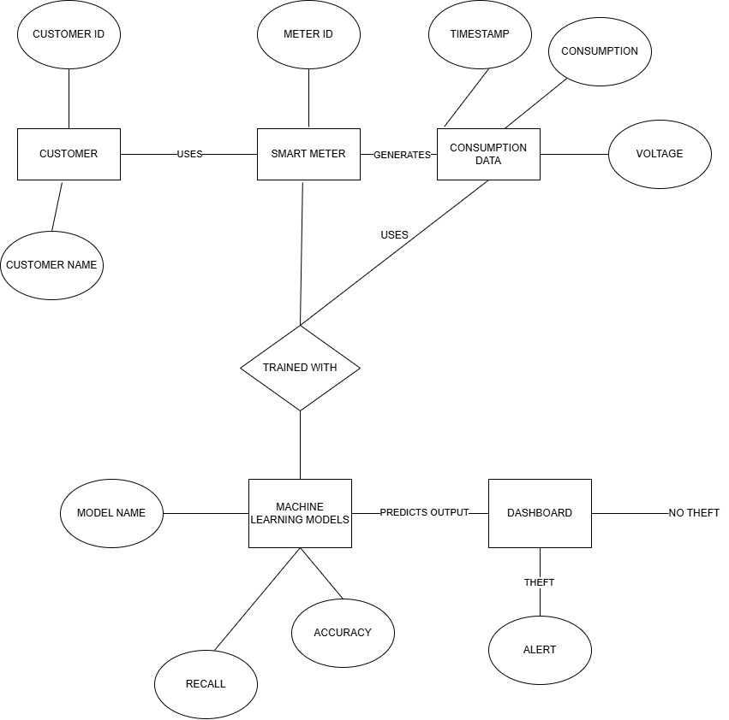
ER DIAGRAM

Slide 9
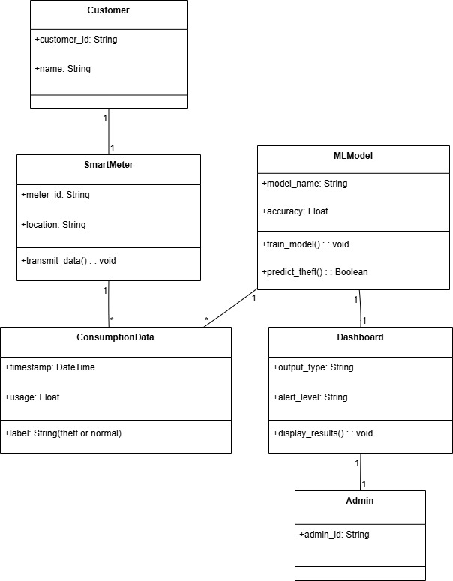
UML DIAGRAMS
Class Diagram

Slide 10
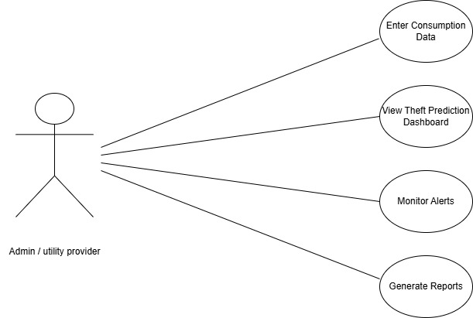
Use Case Diagram

Slide 11
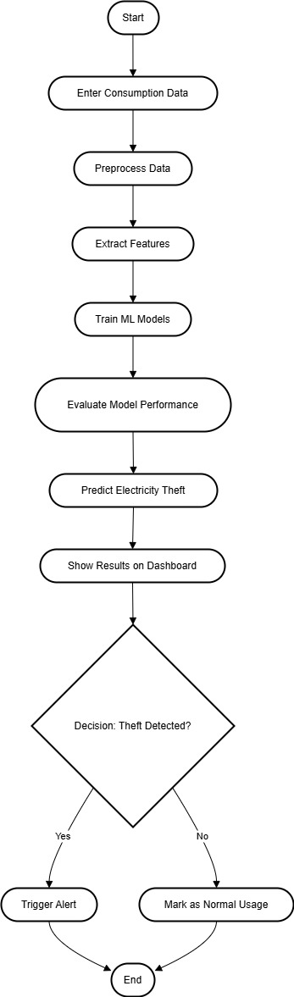
Activity Diagram

Slide 12
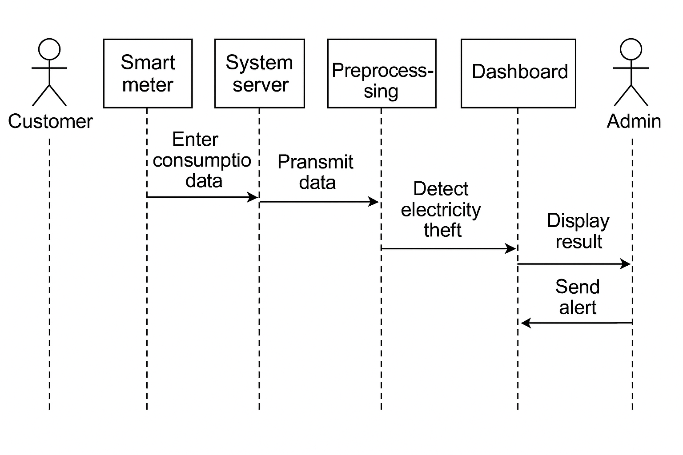
Sequence Diagram

Slide 13
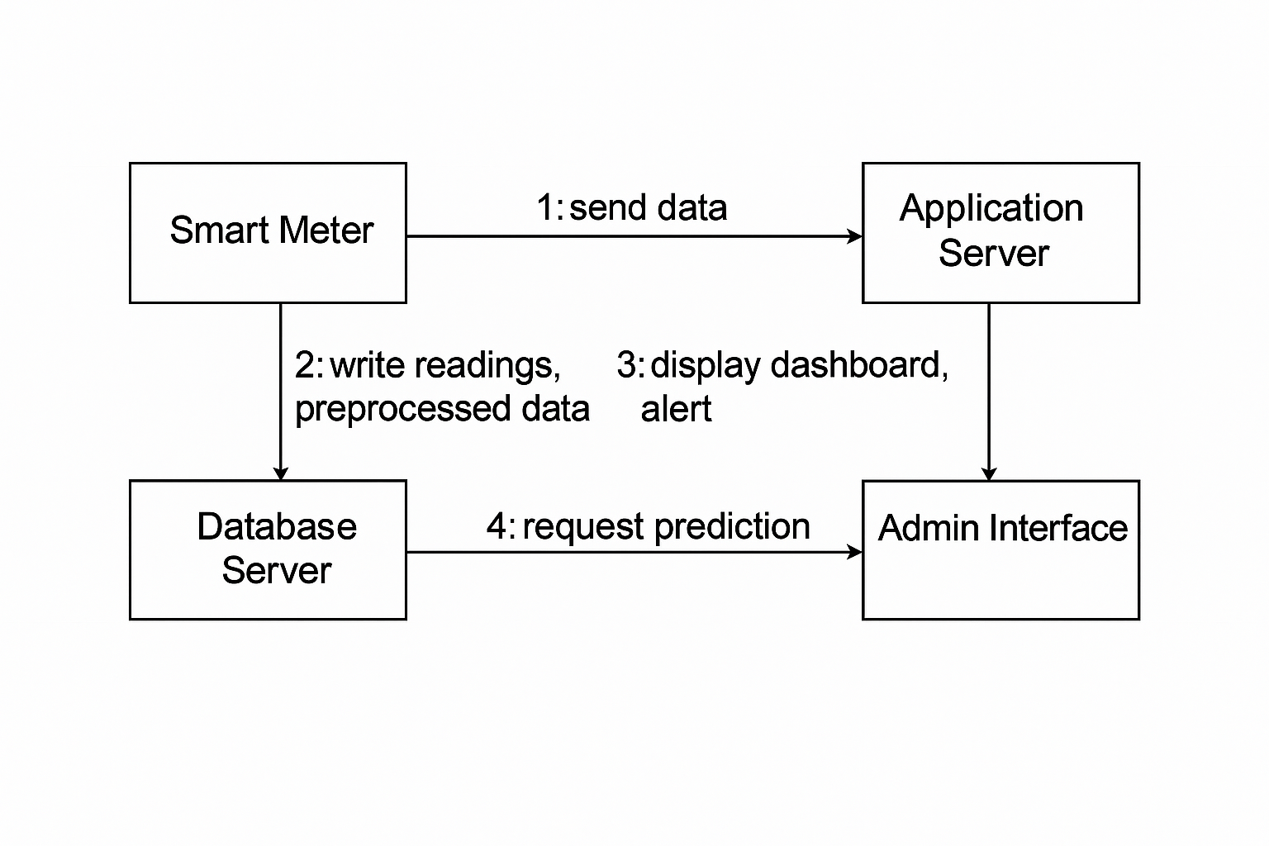
Collaboration diagram

Slide 14
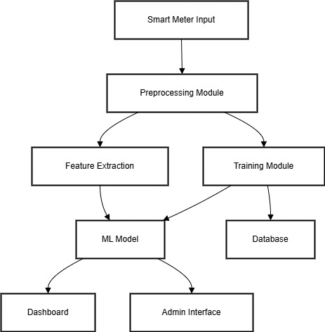
Component Diagram

Slide 15
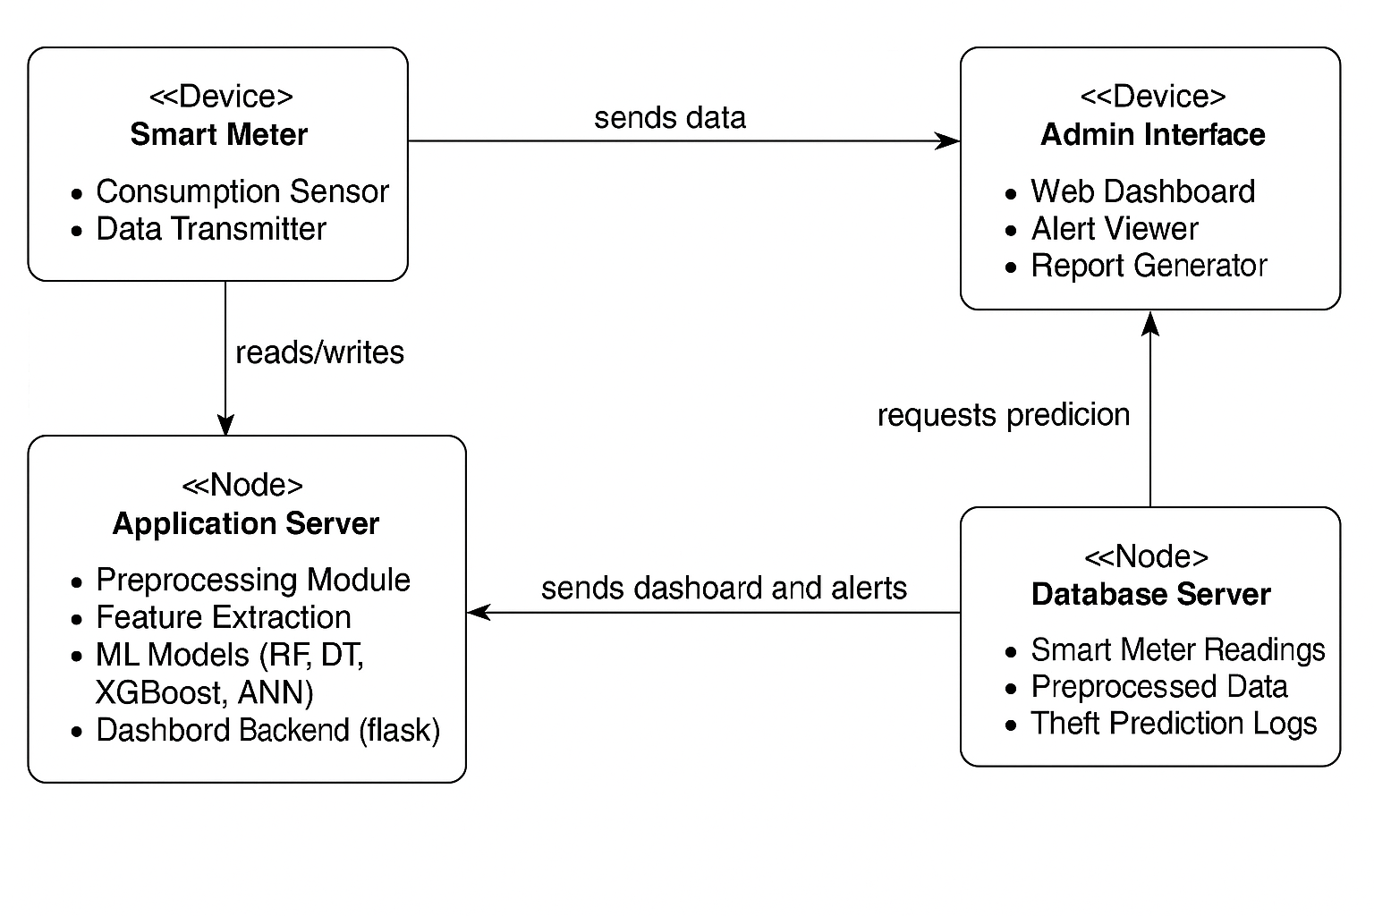
Deployment Diagram

Slide 16
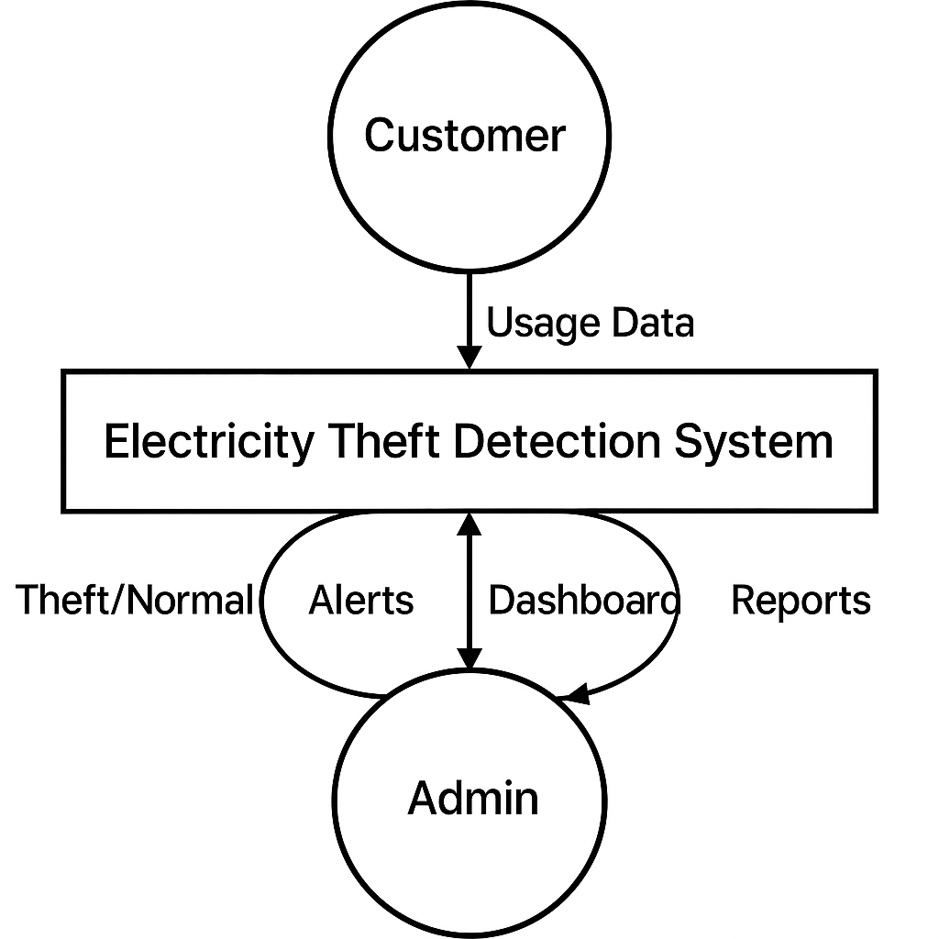
DFD DIAGRAM
Level-0

Slide 17
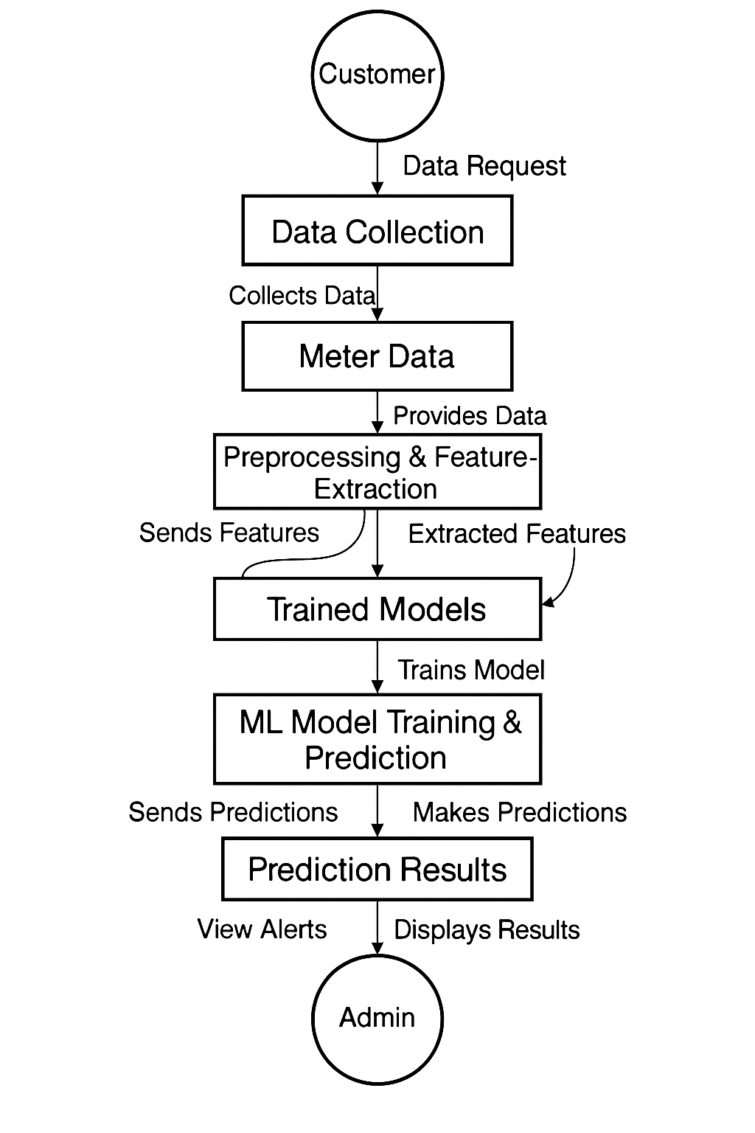
DFD DIAGRAM
Level-1

Slide 18
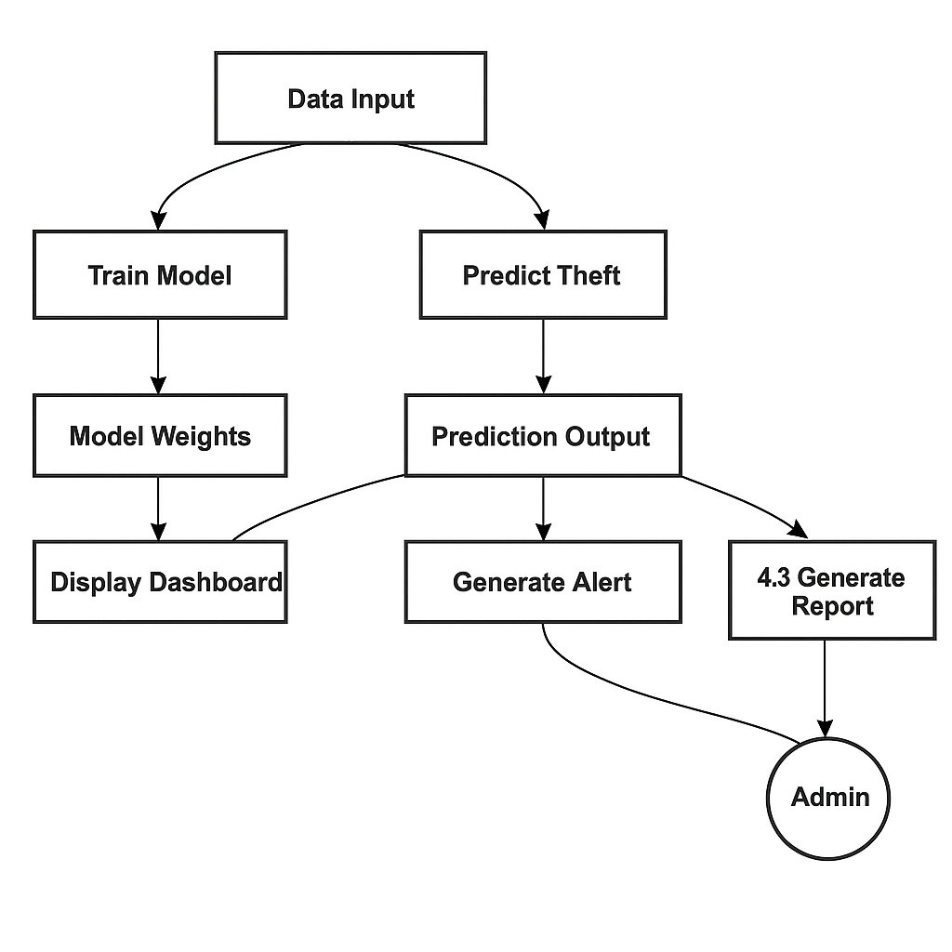
DFD DIAGRAM
Level-2

Slide 19
References
1. A Comprehensive Review on Electricity Theft Detection using ML Techniques – IJERT, 2023.
2. Smart Meter Based Frameworks for Theft Detection – Elsevier Energy Reports, 2022.
3. Comparative Study on ML Classifiers for Power Theft – IEEE Access, 2022.
4. Anomaly Detection Using XGBoost for Power Consumption – Springer, 2021.
5. Real-time Electricity Theft Monitoring via Smart Grids – IEEE IoT Journal, 2023.

Slide 20

THANK YOU

